Slide 1
13.2 Fully Connected Neural Networks

Slide 2
Single-hidden-layer units

Slide 3
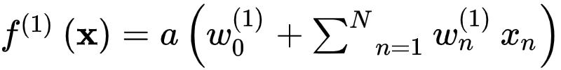
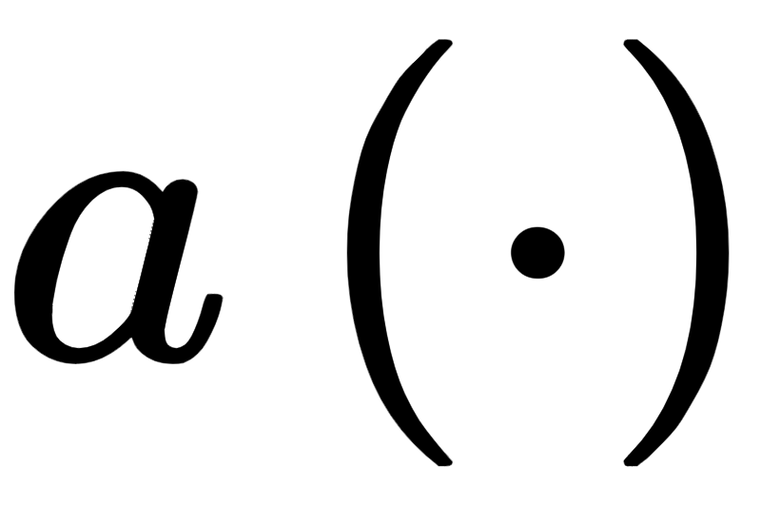
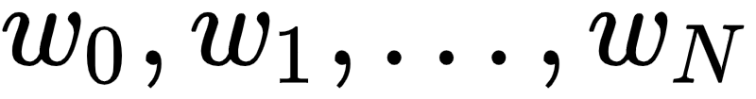
The general algebraic representation (i.e., the formula) of a general single-hidden-layer (or single-layer for short) unit is quite simple: a linear combination of input passed through a nonlinear 'activation' function
Here denotes an activation function and the superscripts on f and indicate they represent a single-layer function and its internal weights respectively.

Slide 4
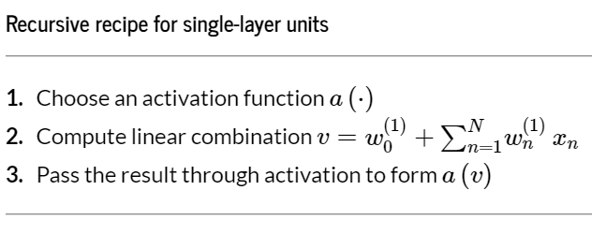

Slide 5
Example: Illustrating the capacity of single layer units

Slide 6

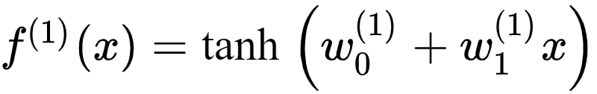
Here we plot four instances of a single-layer unit using as nonlinear activation function. These take the form
In each instance the internal parameters have been set randomly, giving each basis function a distinct shape.

Slide 7
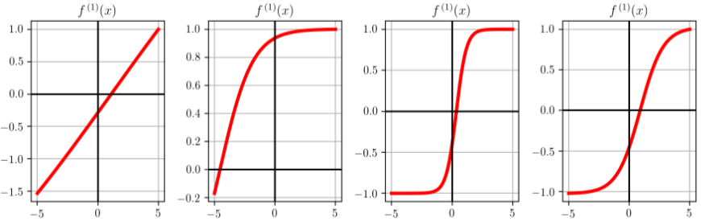

Slide 8
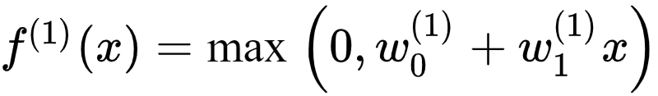
We now repeat this experiment swapping out for the ReLU function, forming a single-hidden-layer unit with ReLU activation of the form
Below we show four instances of this ReLU single-layer unit, where in each instance the unit's internal parameters are set at random.

Slide 9
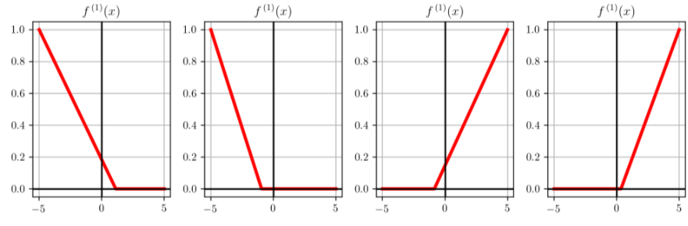

Slide 10


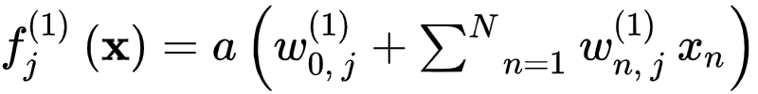



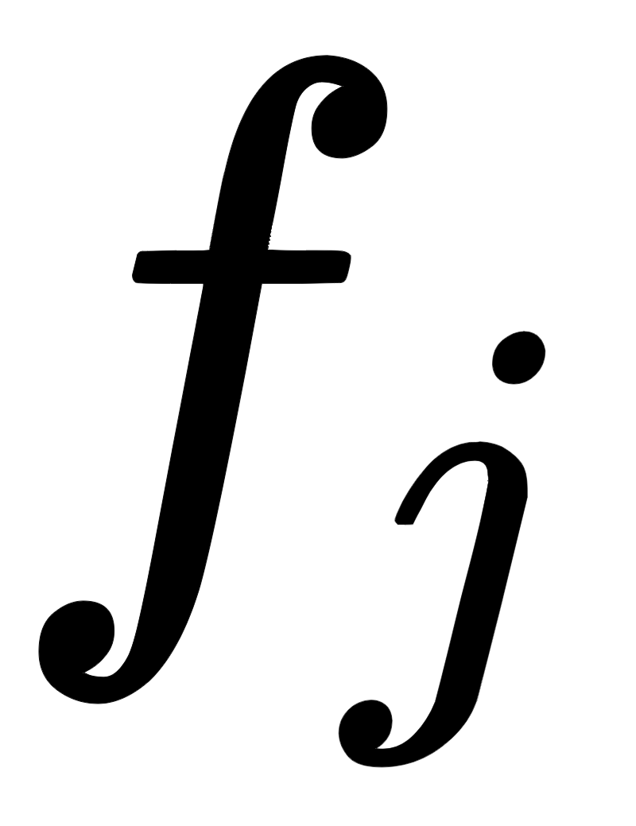
If we form a model using such single-hidden-layer units as
whose element takes the form , the parameter set contains not only the weights of the final linear combination through , but all parameters internal to each as well.

Slide 11
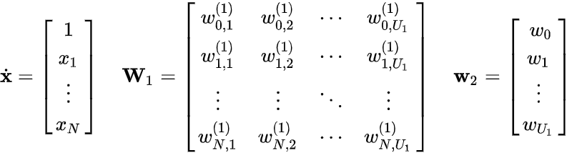
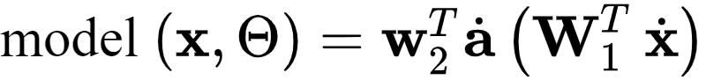
Note that by defining:
our model can be written more simply, compactly, and conveniently as

Slide 12
This more compact algebraic depiction lends itself to much more easily digestible, and extended, visual depictions as illustrated below.

Slide 13
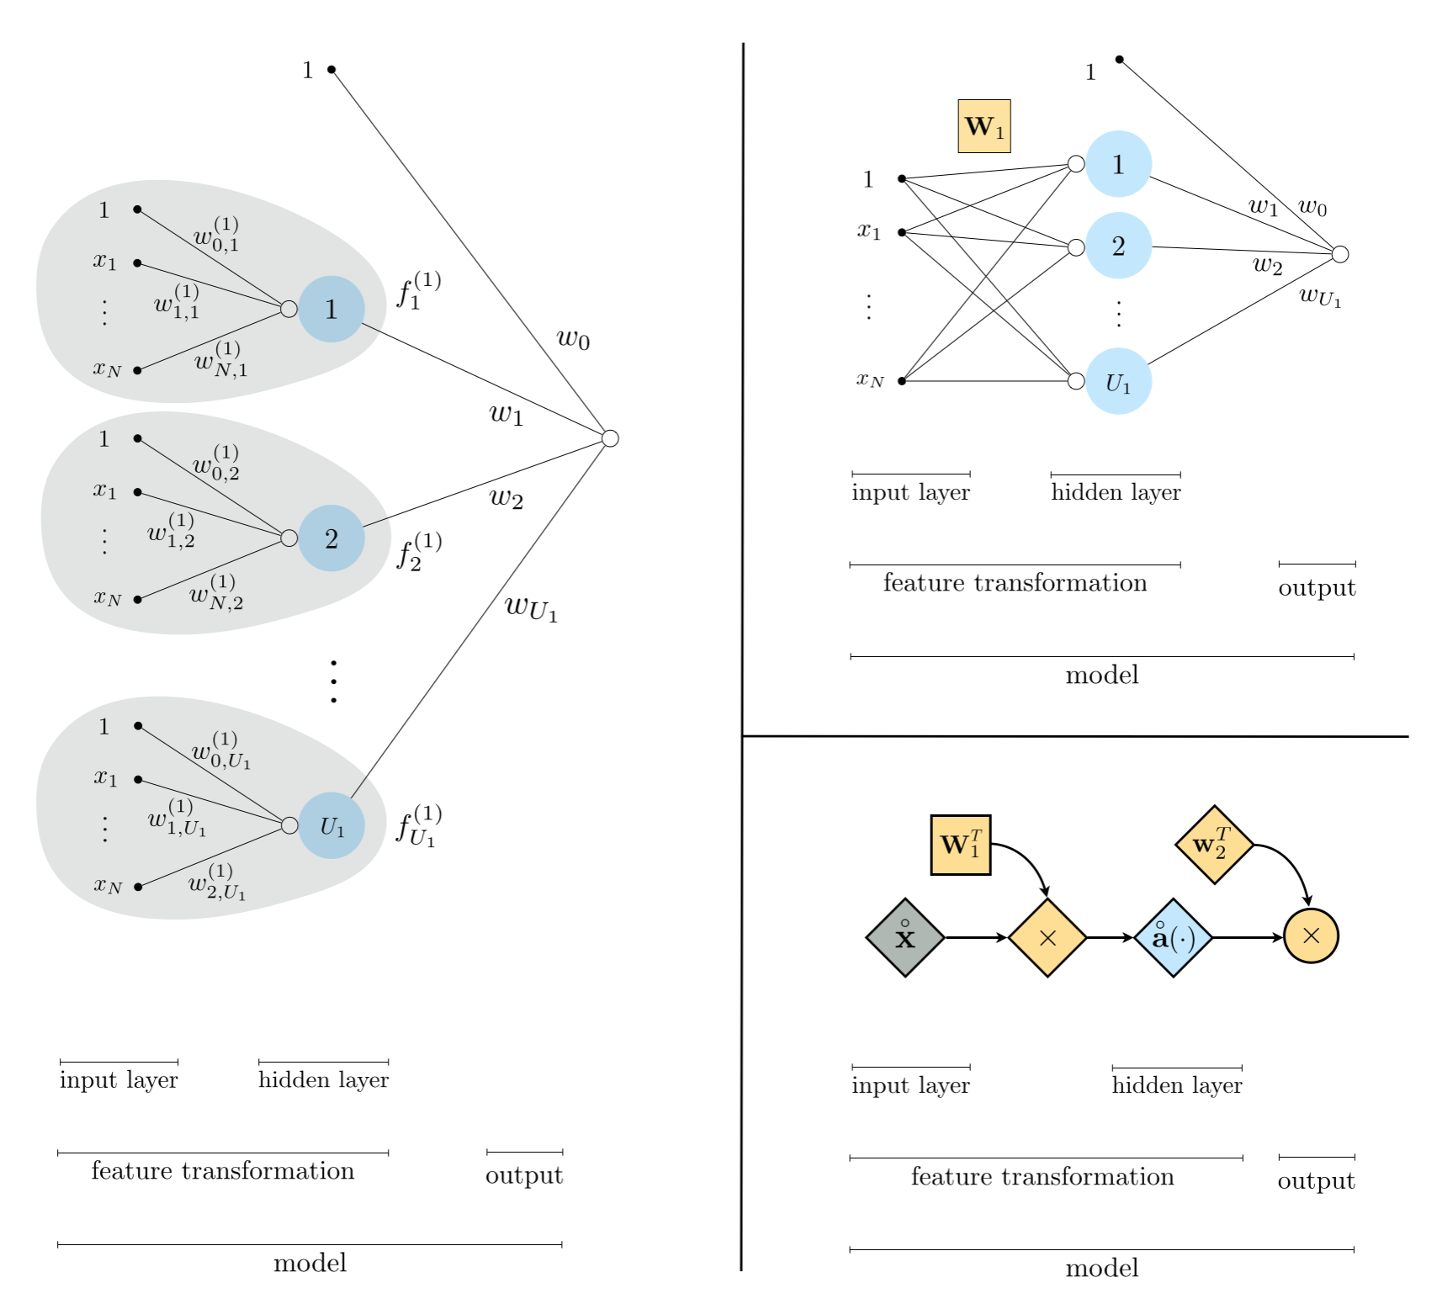
Three equivalent graphical representations of a single-layer neural network model.

Slide 14
Two hidden-layer units

Slide 15

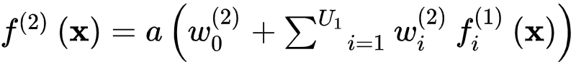
To create a two-layer unit we *recurse* on the idea of the single-layer unit detailed previously, by first constructing a set of single layer units and treat them as input: we take their linear combination and pass the result through a nonlinear activation

Slide 16
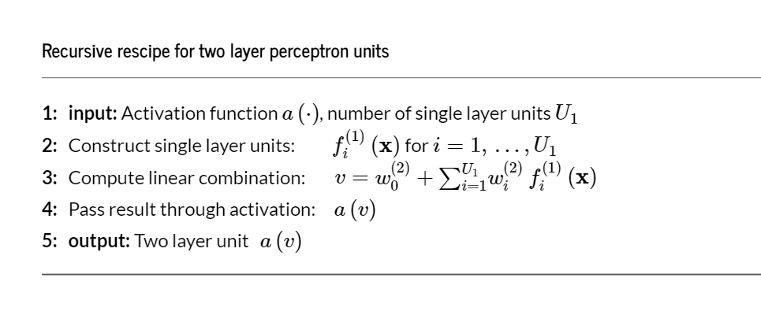

Slide 17
Example: Illustrating the capacity of two-layer units

Slide 18
We plot four instances of a two-layer function using as activation, akin to what we did in the previous example.
All weights are again set randomly in each instance.

Slide 19
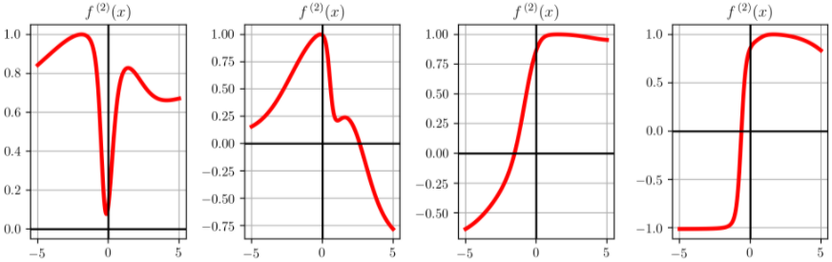

Slide 20
Below we show four exemplars of the same sort of unit - only now we use the ReLU activation instead of the .

Slide 21
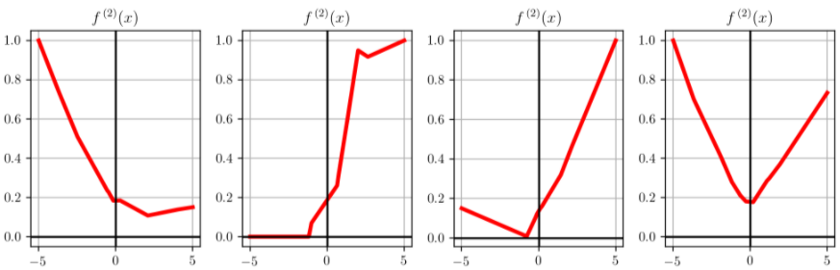

Slide 22
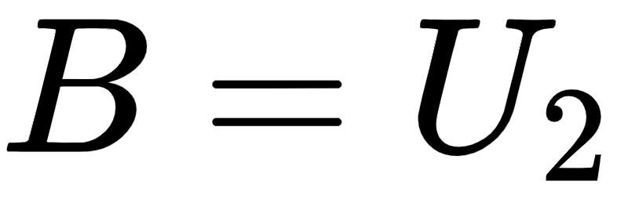
In general if we wish to create a model using such two layer units we have
Here the parameter set both those weights internal to the units as well as the final linear combination weights.

Slide 23
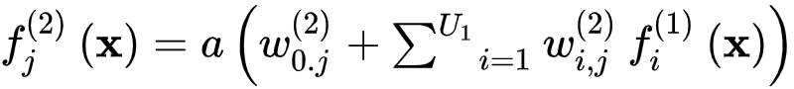
Notice in this case that each two layer unit now has its own unique internal parameters in the linear combination of single layer units (but the weights intnernal to the single layer units are the same for each two layer unit we define). The of which looks like

Slide 24
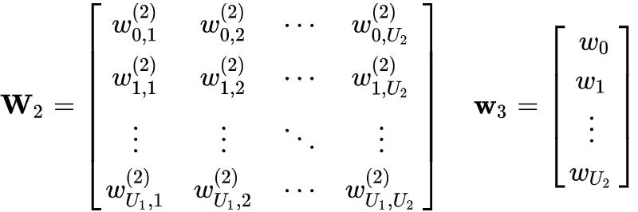
Once again, carrying over our compact notation and defining:
we can write our model much more compactly as

Slide 25
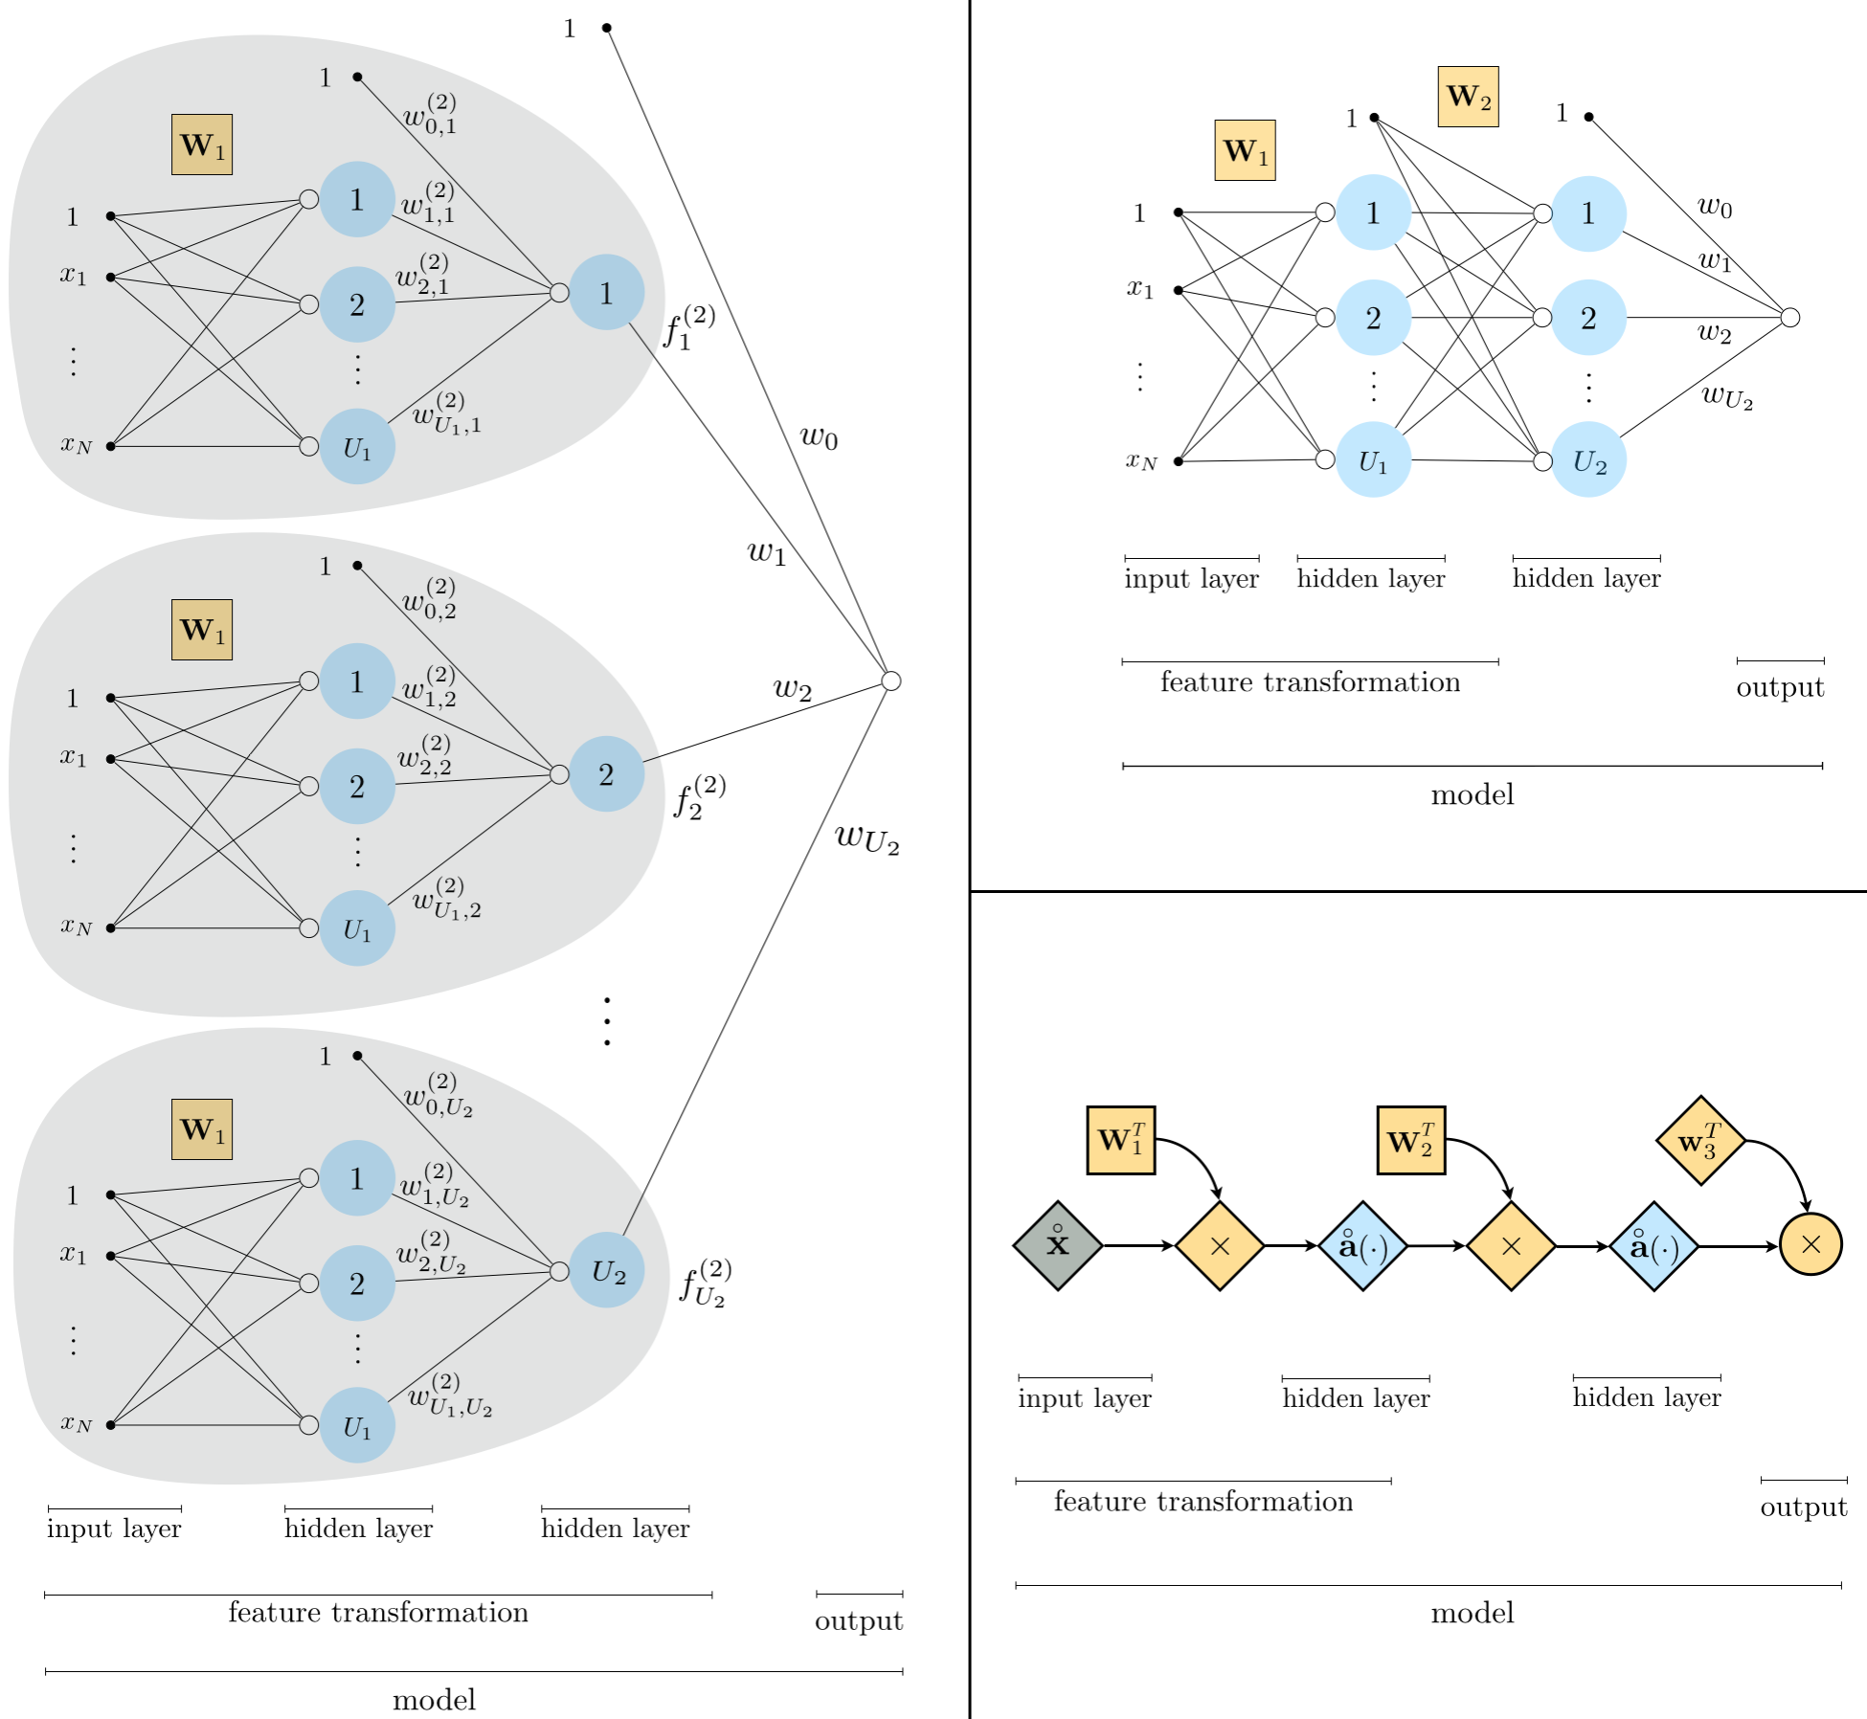
Three graphical representations of a two-layer neural network model.

Slide 26
General multi-layer perceptron units

Slide 27
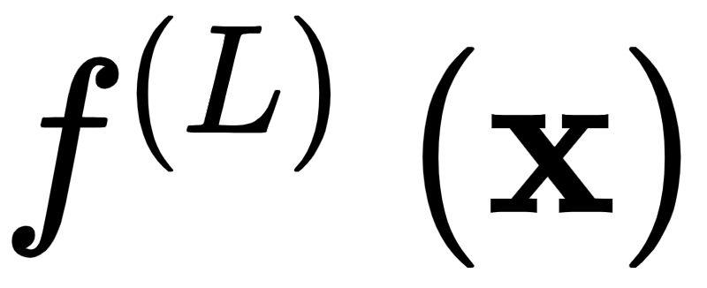
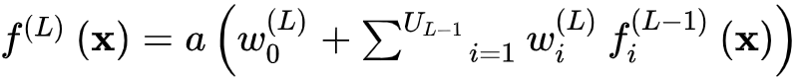
The algebraic form of an L-layer unit is given by the formula
which reflects the recursive nature of the L layer unit algebraically.

Slide 28
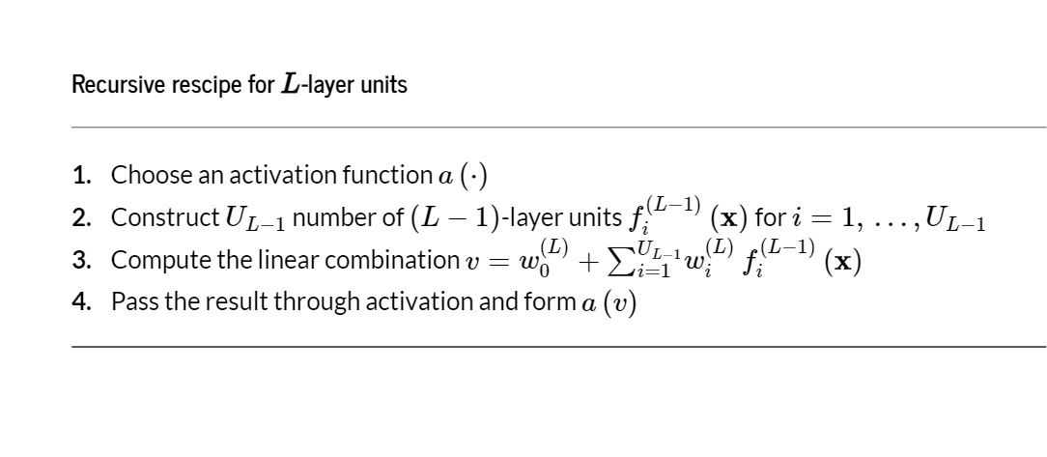

Slide 29
Example: Illustrating the capacity of three-layer units

Slide 30

In this example we show four instances of a three-layer perceptron unit with activation functions.
Often a model composed of units that have three or more hidden layers is called a *deep network*.

Slide 31
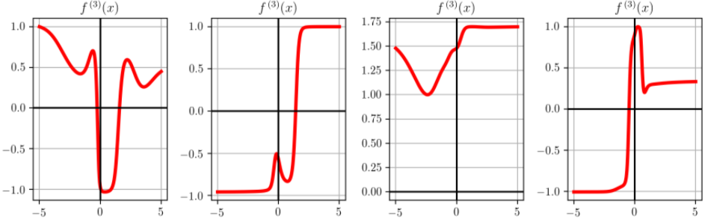

Slide 32
Below we repeat the same experiment, only using the ReLU activation function instead of .

Slide 33
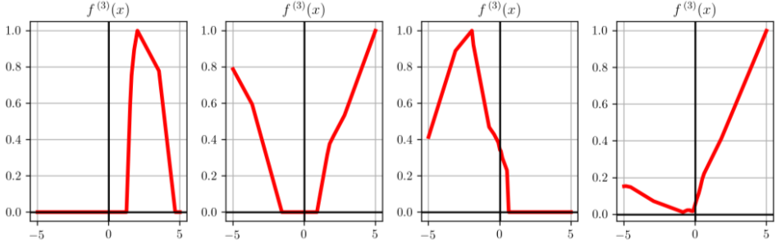

Slide 34
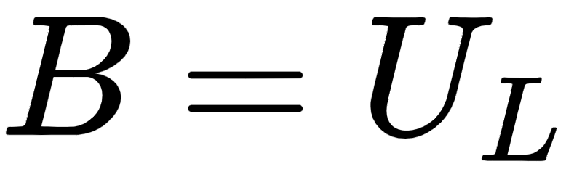
In general we can produce a model consisting of such L layer units
where parameter set both those weights internal to the units as well as the final linear combination weights. The unit takes the familiar form

Slide 35
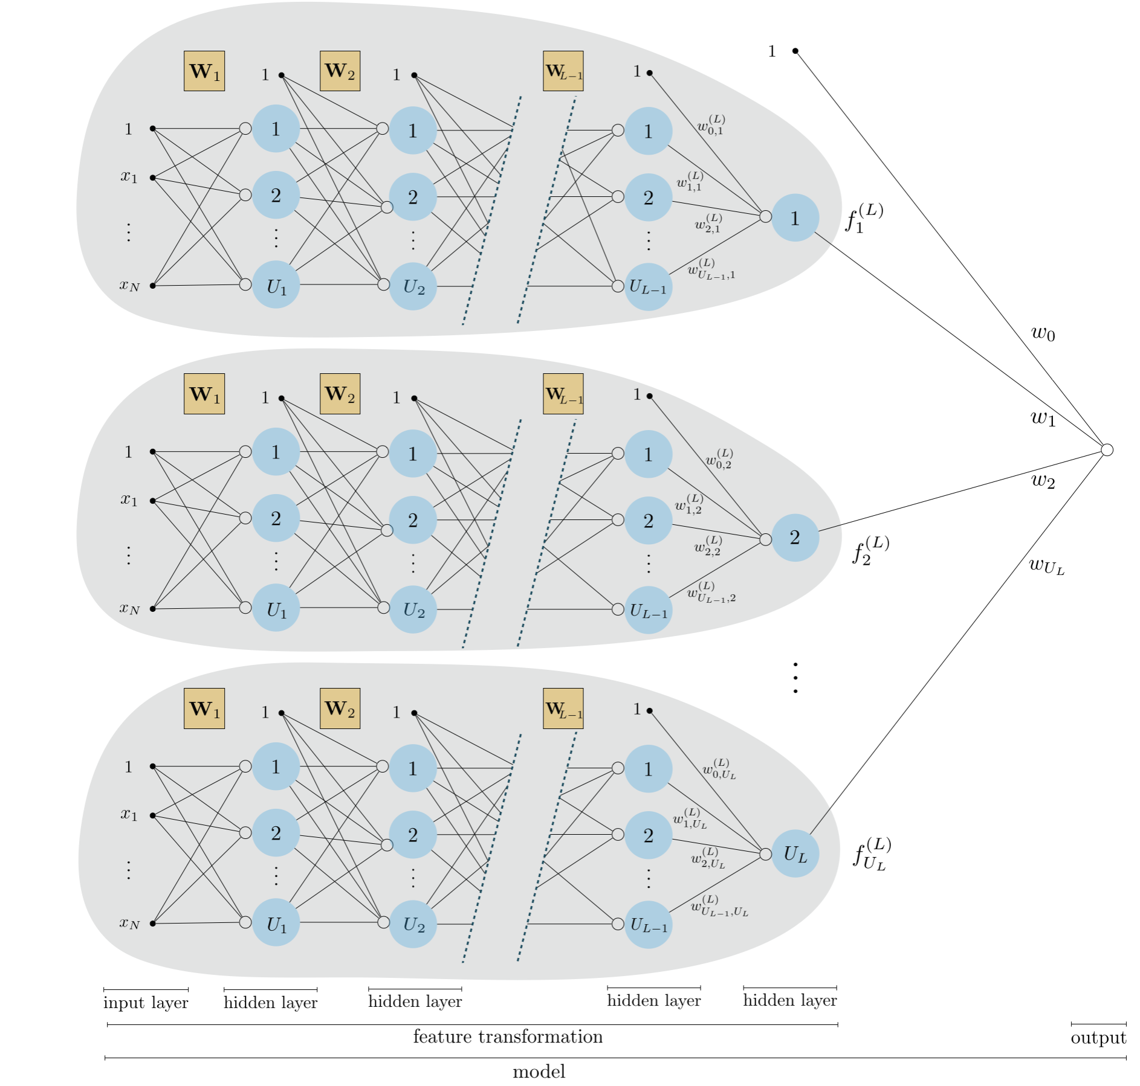
Graphical representation of an L-layer neural network model.

Slide 36
Once again, we can express the model of L-layer units compactly as
This compact form allows for more condensed and convenient graphical representations of our model as depicted below.

Slide 37
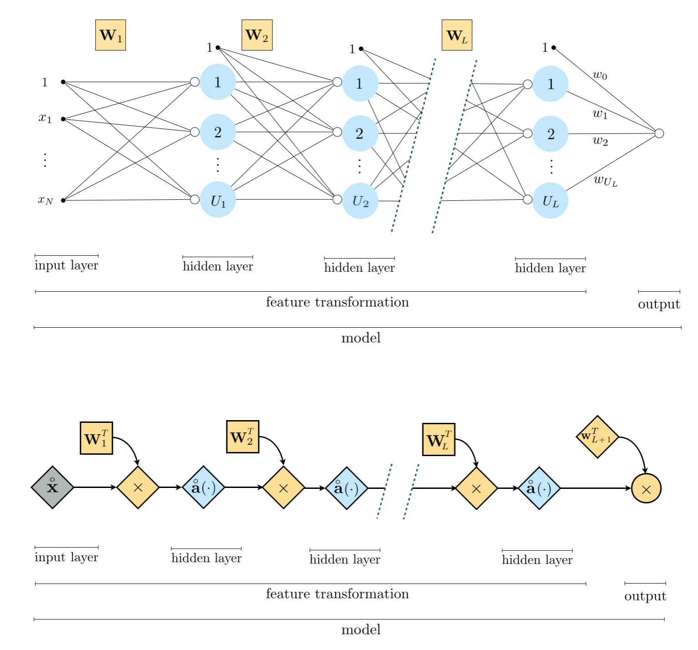
Two graphical representations of an L-layer neural network.

Slide 38
Biological model of a single hidden-layer unit

Slide 39
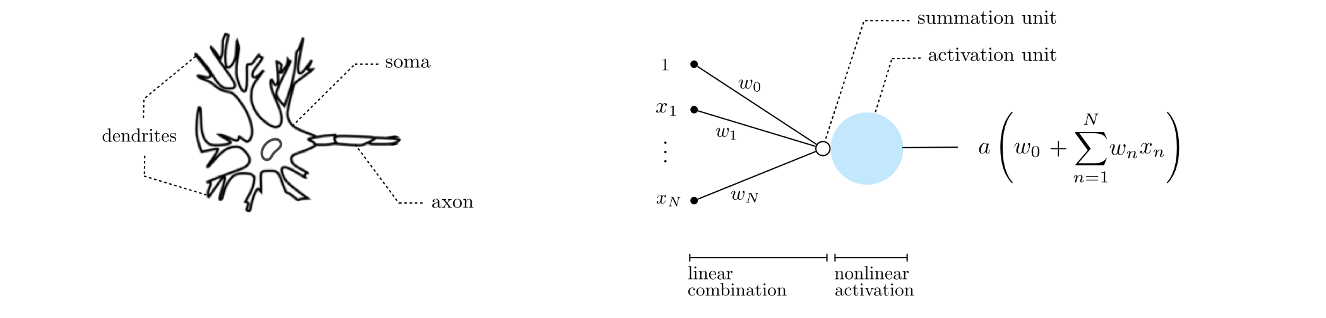
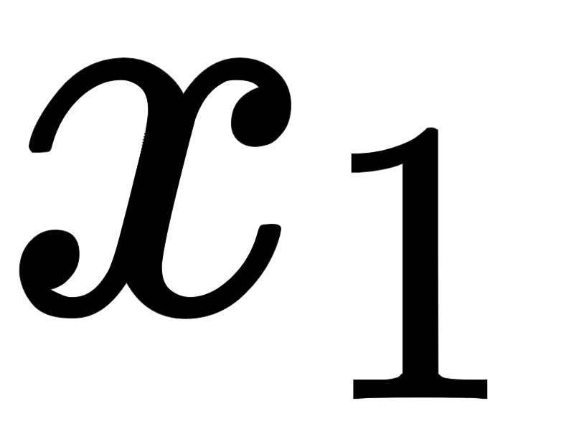

(left) A typical biological neuron. (right) An artificial neuron (also called a perceptron). An artificial neuron is a simplistic mathematical model for the biological neuron consisting of: (i) weighted edges that represent the individual multiplications (of 1 by , by , etc.), (ii) a summation unit shown as a small hollow circle representing the sum , and (iii) an activation unit shown as a larger blue circle representing the sum evaluated by the nonlinear activation function ‘a’.

Slide 40
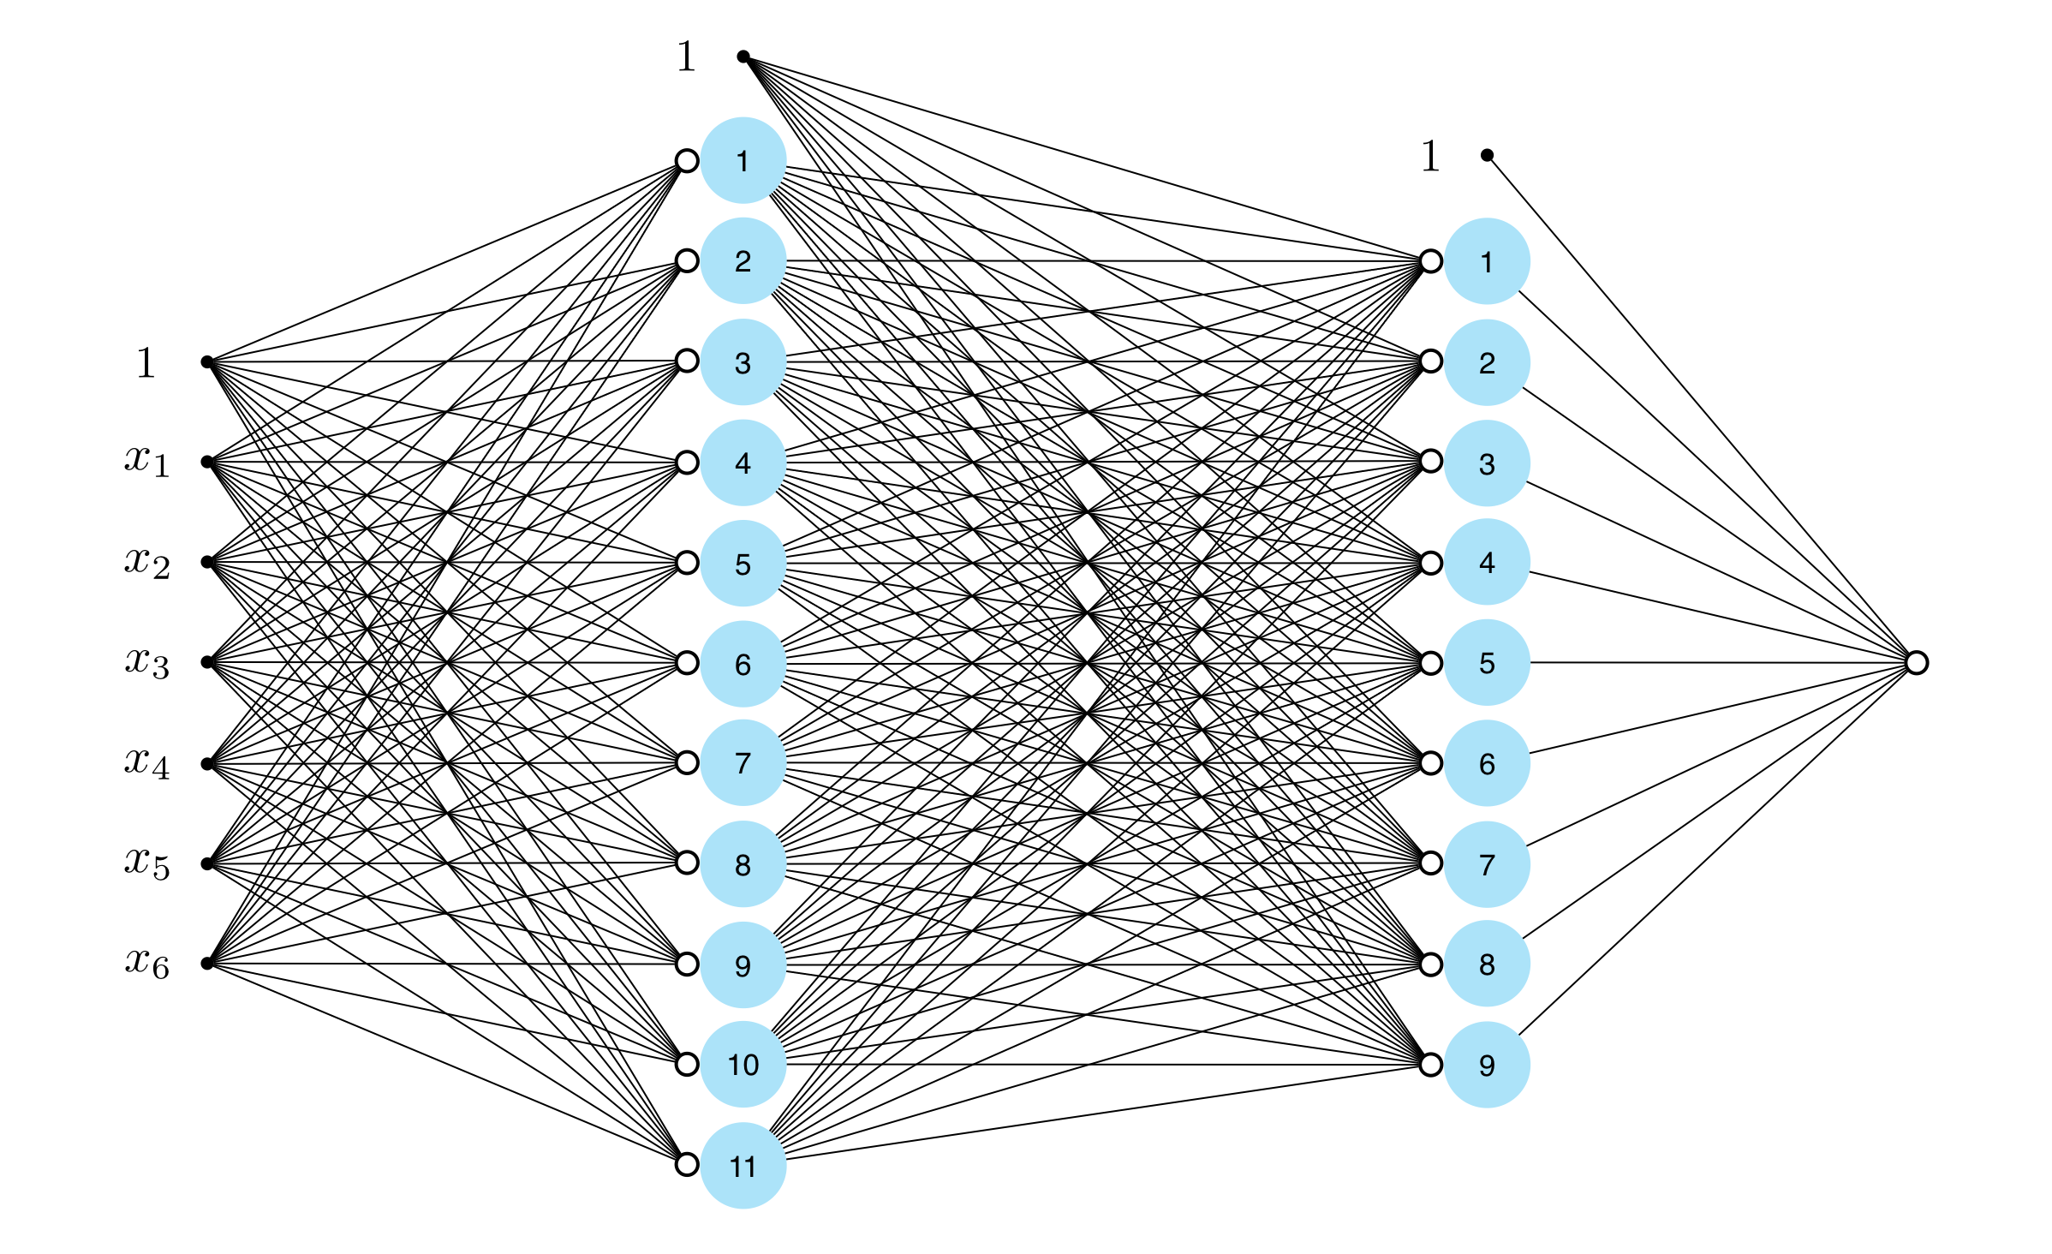
An example of a two layer network as commonly illustrated when detailing neural networks from a biological perspective. The complex mesh of edges makes this sort of visualization rather difficult to interpret.

Slide 41
Example: Nonlinear two-class classification example using multilayer perceptrons

Slide 42

Number of hidden layers: 4
Number of units per layer: 10
Activation:
Cost: Softmax
Optimizer: gradient descent

Slide 43
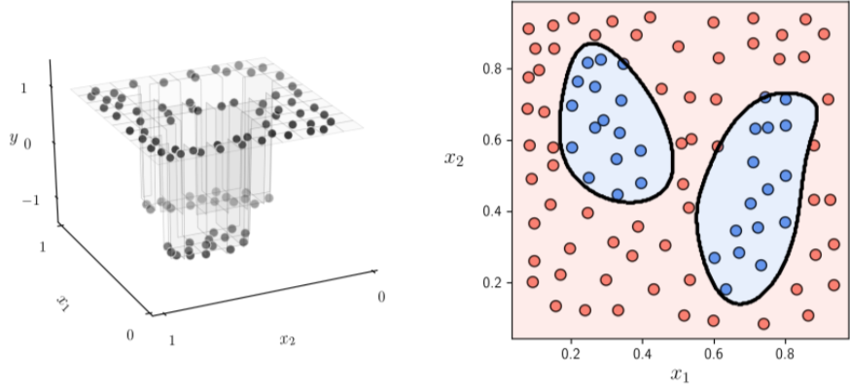

Slide 44
Example: Nonlinear multiclass classification using two layer units

Slide 45

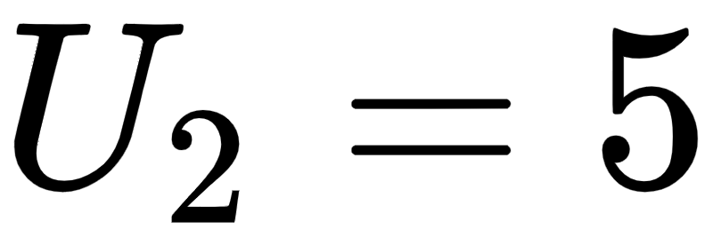
Number of hidden layers: 2
Number of units per layer: and
Activation:
Cost: Multi-class Softmax
Optimizer: gradient descent

Slide 46
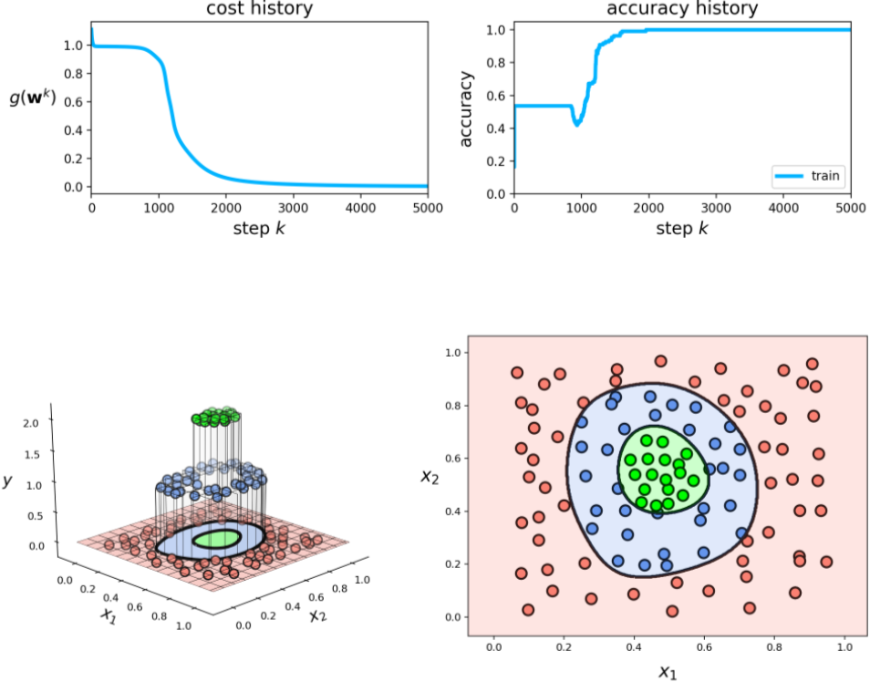

Slide 47
Example: Learning a nonlinear manifold using multilayer perceptron encoding/decoding functions

Slide 48
Number of hidden layers (for both encoder and decoder): 3
Number of units per layer: 10
Activation:
Cost: Autoencoder
Optimizer: gradient descent

Slide 49
